Slide 1
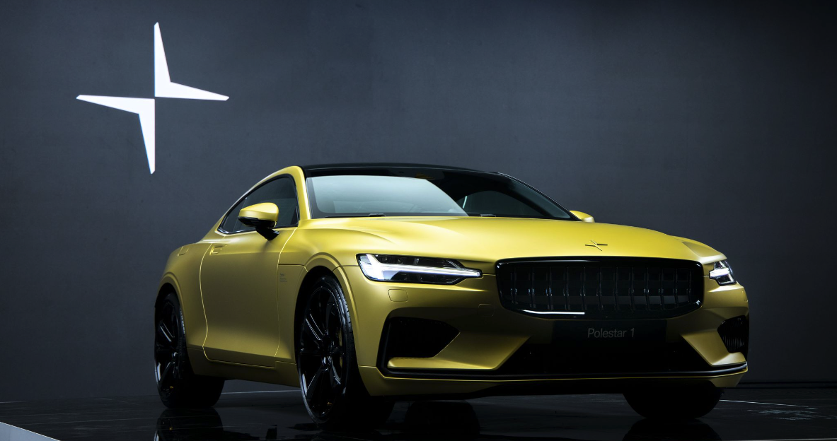
Predicting Polestar Success
Using data analysis of TESLA stock
to determine Polestar success
Notes:
We represent Polestar, an up-and-coming electric vehicle that went public in June 2022.
Proficiency talking points:
Selected topic
Reason why we selected the topic

Slide 2










Overview
Purpose of Project:
Determine whether past stock performance of electric vehicles can predict future stock performance of Polestar.
Questions to Answer:
Can historical stock prices from other electrical vehicles predict growth of Polestar?
How well suited is Polestar to be competitive in the market?
Faraday Future
Team:
Tracey Fitzpatrick
Cheryl Farnsworth
Kelly Nichols
Holly Smith
Notes:
Our team wondered whether historical stock prices from other electric vehicles (EV) could predict growth of this recent addition to the market.
Proficiency talking points:
Selected topic
Reason why we selected the topic
Questions to answer

Slide 3





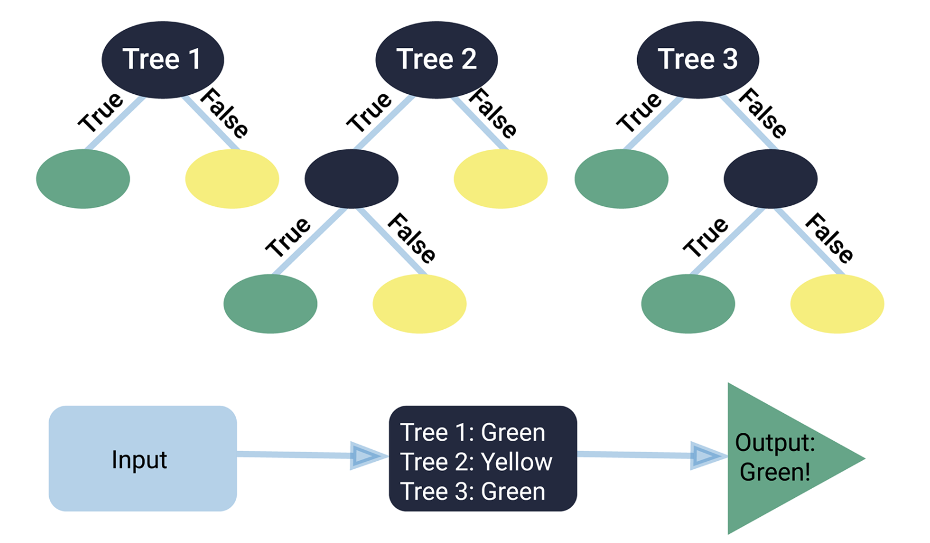


Technologies Used
Random Forest Classifier
Notes:
Is this correct?
Proficiency talking point:
Technologies, languages, tools, and algorithms used throughout the project

Slide 4
Data Exploration
Notes:
Proficiency talking points:
1) description of source data
2) description of the data exploration phase of the project

Slide 5
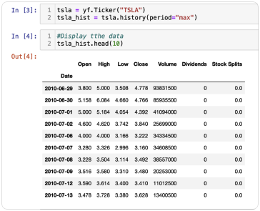
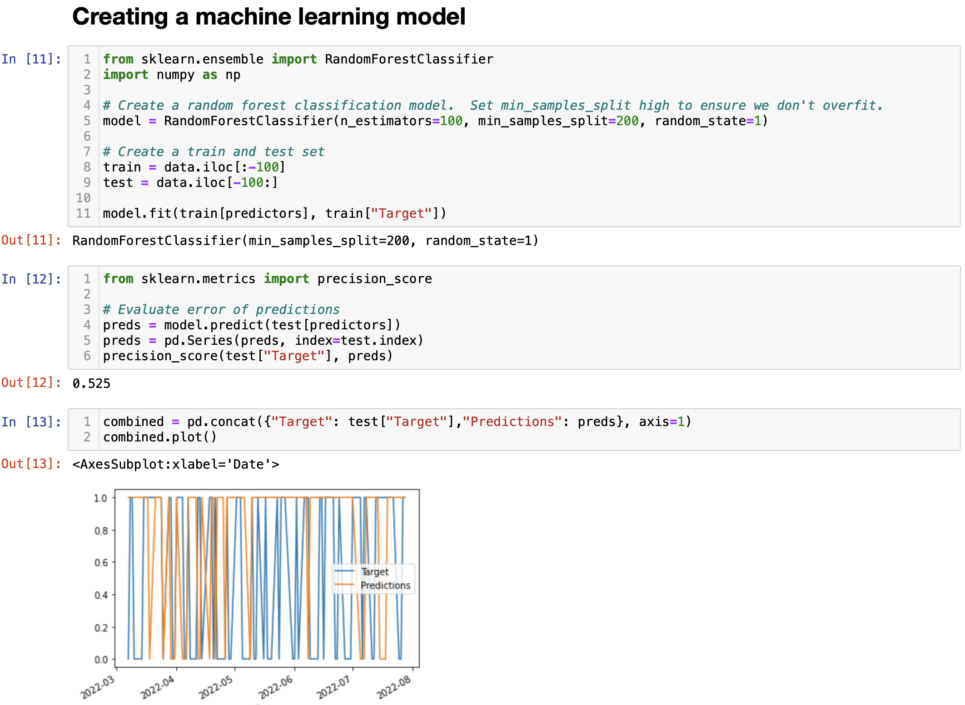
Model Analysis
Our model uses historical pricing and trading volume to predict future share prices for the top 10 electric vehicle companies and potential growth for Polestar.
Step 1: Pull pricing from Yahoo Finance API
Step 2: Predict future pricing for each EV stock
Notes:
We need better pictures – the larger pick is from the README but is not exactly the same as the original. I can’t find Step 1 in the code to re-paste. –Holly
Proficiency talking point:
Description of the analysis phase of the project

Slide 6
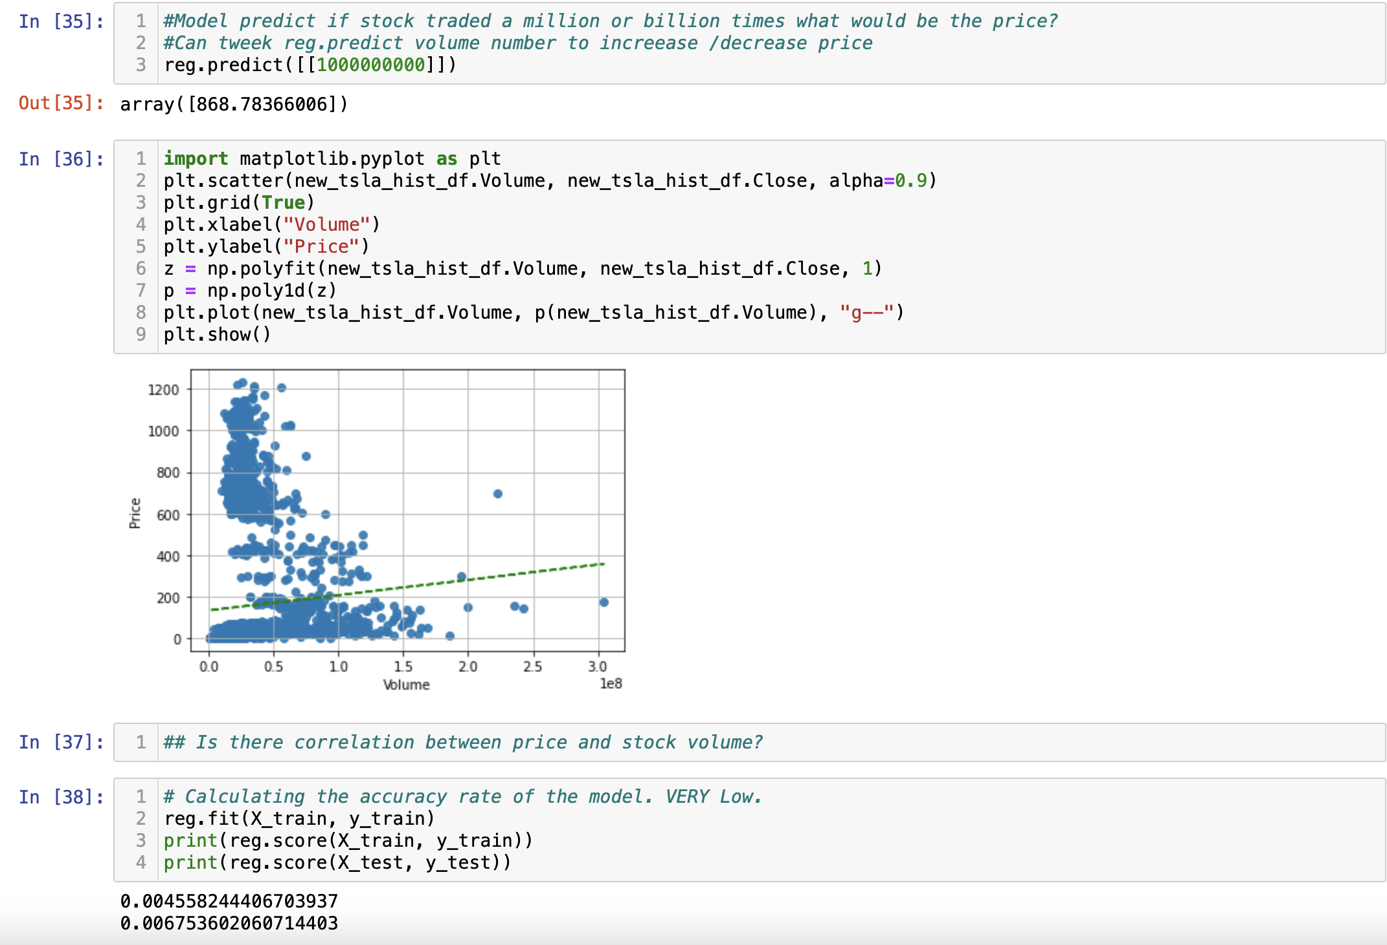
Model Analysis
Step 3: Predict future share price based on trading volume
* There is a correlation between price and volume but accuracy rate is very low.

Slide 7

Results
If Polestar is to take on Telsa in the EV market, it will need to expand their business model and invest in marketing to compete with Tesla’s tremendous brand recognition in the industry.
If Polestar continues with the current EV vehicles only model, there is a good chance that share prices will rise to the same level as other similar EV companies.
Notes:
Proficiency talking point: results of analysis

Slide 8
Dashboard
Placeholder

Slide 9
Recommendations
Notes:
Proficiency talking point:
Recommendation for future analysis

Slide 10
What the team would have done differently
Notes:
Proficiency talking point:
Anything the team would have done differently.

Slide 11
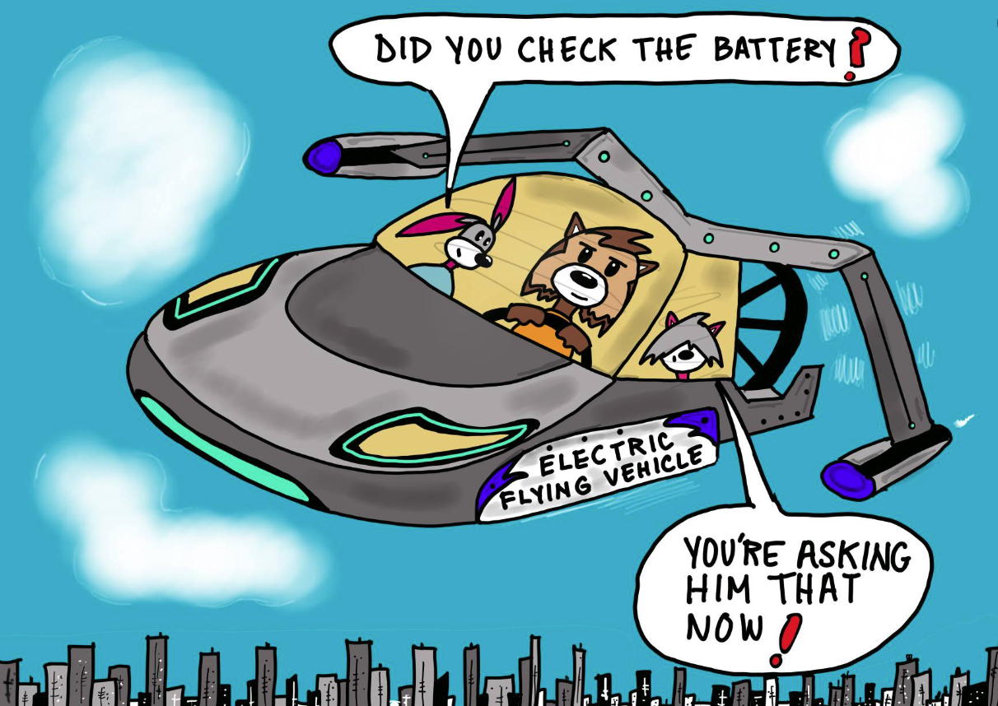
Notes:
End on a funny note, e.g., “the future is right around the corner…” ?

